Slide 1

Chapter 1, Part 2
Database Systems
Notes:
The slides in this presentation have been adapted from slides provided with the textbook, Database Systems: Design, Implementation, and Management, 12E, Cornel and Morris, Copyright © 2017 Cengage Learning.

Slide 2
Learning Objectives
About flaws in file system data management
The importance of database design
Structural and Data Independence and Dependence
Data Redundancy and Anomalies
Copyright © 2017 Cengage Learning
2

Slide 3
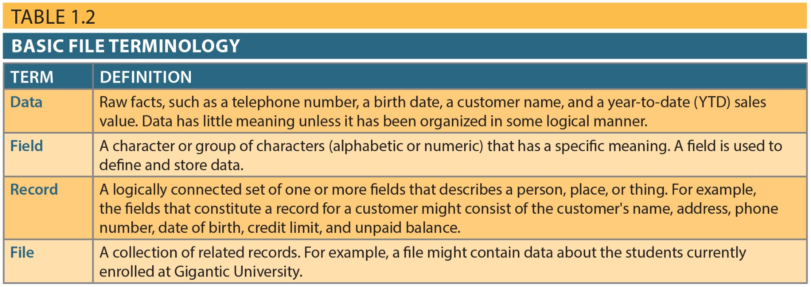
Table 1.2 - Basic File Terminology
Copyright © 2017 Cengage Learning
3

Slide 4
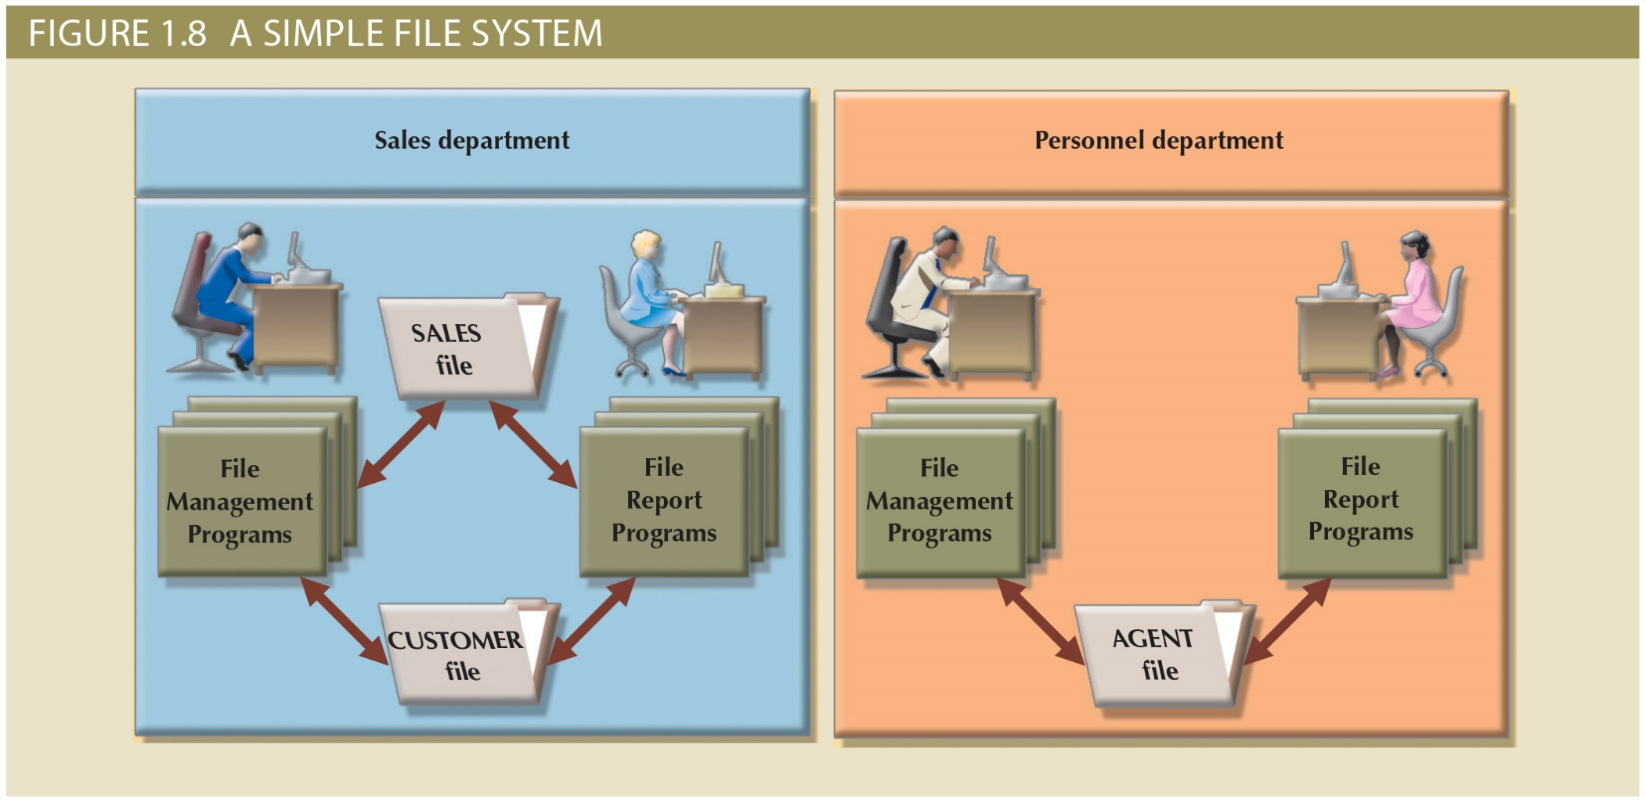
Figure1.6 - A Simple File System
Copyright © 2017 Cengage Learning
4

Slide 5
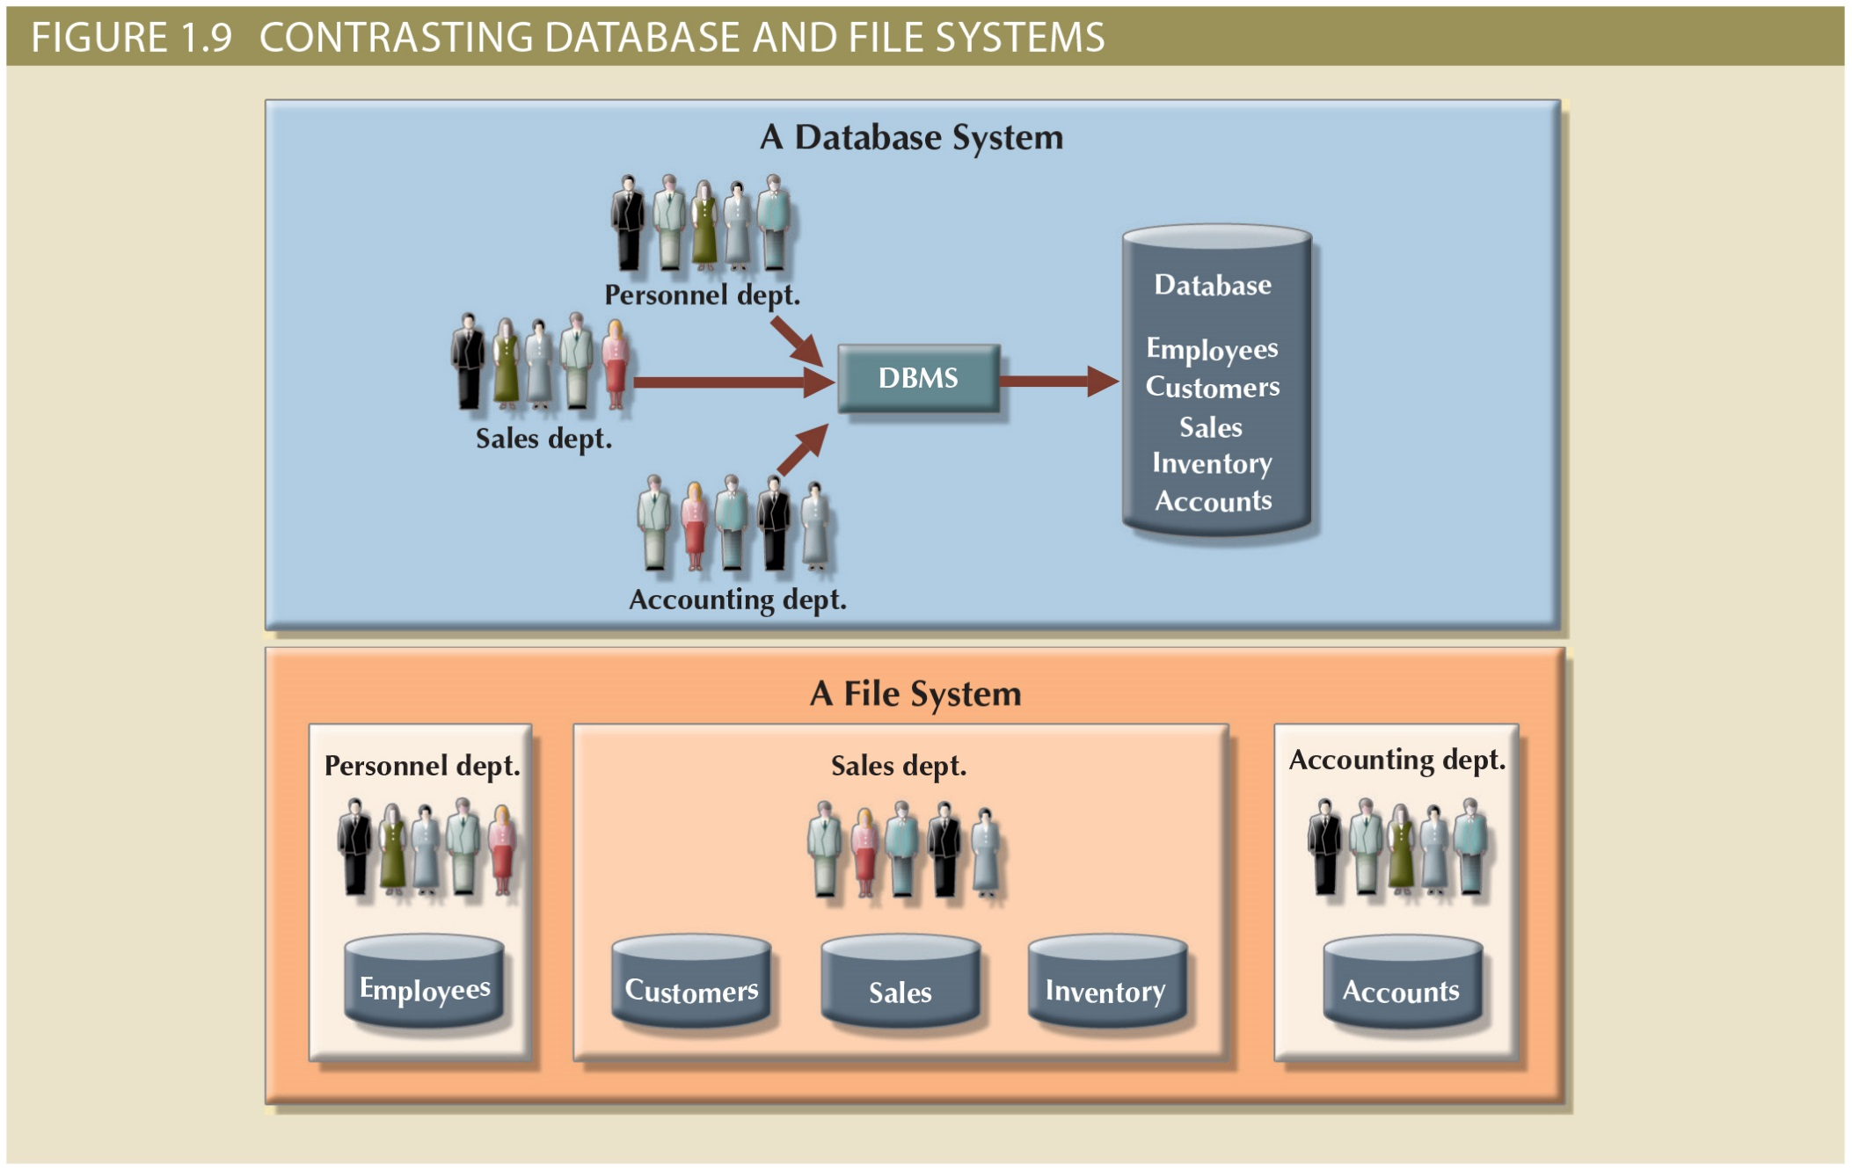
Figure 1.8 - Contrasting Database and File Systems
Copyright © 2017 Cengage Learning
5

Slide 6
Problems with File System Data Processing
File systems were an improvement over manual system
File systems used for more than two decades
Understanding the shortcomings of file systems aids in development of modern databases
Many problems not unique to file systems
Even simple file retrieval tasks required extensive programming
Ad hoc queries impossible
Changing existing structure difficult
Copyright © 2017 Cengage Learning
6

Slide 7
Problems with File System Data Processing (cont'd.)
Security features difficult to program
Often omitted in file system environments
Summary of file system limitations:
Requires extensive programming
Cannot perform ad hoc queries
System administration is complex and difficult
Difficult to make changes to existing structures
Security features are likely to be inadequate
No multi-user/record locking access possible
Backup is simple file copy operation
Copyright © 2017 Cengage Learning
7

Slide 8
Data Integrity
The condition in which al data in the DB are consistent with real-world events and states.
Data are accurate - there are no data inconsistencies
Data are verifiable – the data will always lead consistent results
Copyright © 2017 Cengage Learning
8

Slide 9
Structural and Data Dependence
Structural dependence: Access to a file is dependent on its own structure
All file system programs are modified to conform to a new file structure
Structural independence: File structure is changed without affecting the application’s ability to access the data
Copyright © 2017 Cengage Learning
9

Slide 10
Structural and Data Dependence
Data dependence
Data access changes when data storage characteristics change
Needing to know the physical format of the file is data dependence
Data independence
Data storage characteristics change without affecting the program’s ability to access the data
A logical approach of data access provides data independence
Copyright © 2017 Cengage Learning
10

Slide 11
Data Redundancy
Unnecessarily storing same data/fact at different/multiple places
Islands of information: Scattered data locations
Increases the probability of having different versions of the same data
Creates Data anomalies
Develops when not all of the required changes in the redundant data are made successfully
Copyright © 2017 Cengage Learning
11

Slide 12
Data Redundancy (cont'd.)
Data inconsistency: different and conflicting versions of same data occur at different places
Data anomalies: abnormalities when all changes in redundant data are not made correctly
Update anomalies
Insertion anomalies
Deletion anomalies
Copyright © 2017 Cengage Learning
12

Slide 13
Lack of Design and Data-Modeling Skills
Evident despite the availability of multiple personal productivity tools being available
Data-modeling skills are vital in the data design process
Good data modeling facilitates better problem solving through communication between the designer, user, and the developer
Copyright © 2017 Cengage Learning
13

Slide 14
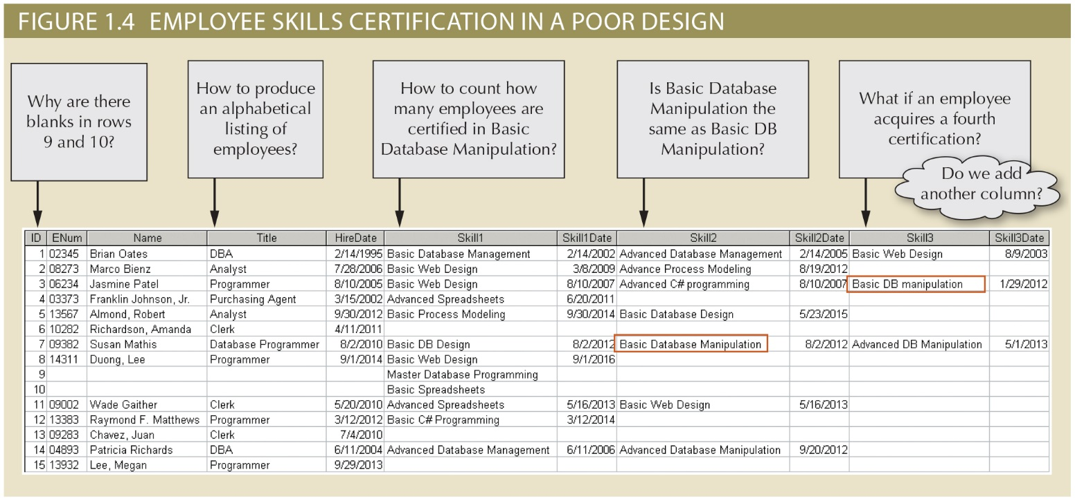
Figure 1.5- Bad Design for Skill System
Copyright © 2017 Cengage Learning
14

Slide 15
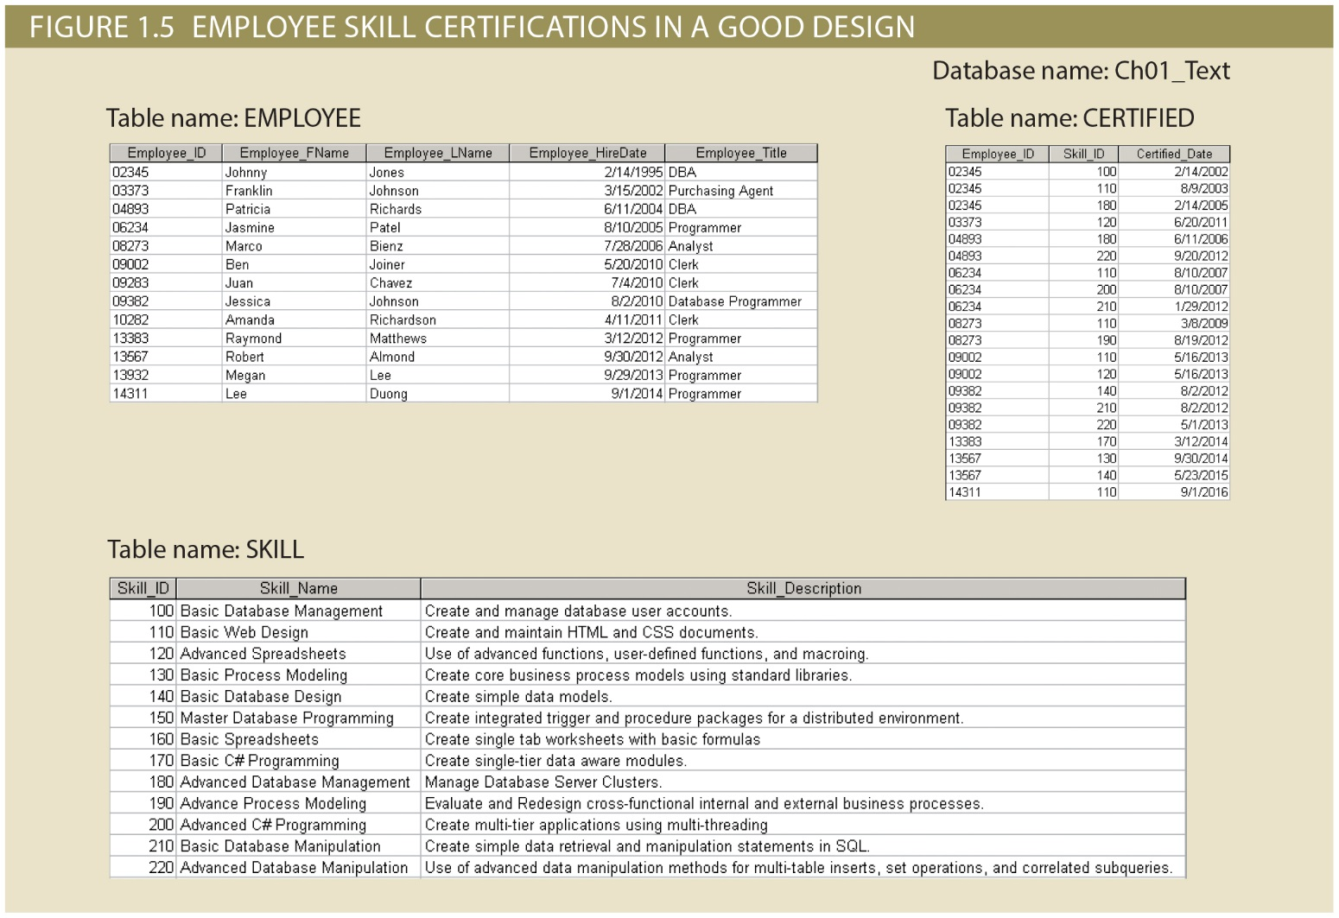
Figure 1.5- Good Design for Skill System
Copyright © 2017 Cengage Learning
15

Slide 16
Summary
Eliminating data redundancy is a major advantage of good design
Data Anomalies mean your programs are more complex and difficult to modify
Database design skills produce data structures without any redundancy or data anomalies
Copyright © 2017 Cengage Learning
16

Slide 17
Task
Define Data Integrity: ___________________________________
List the types of Data anomalies: ___________________________________
What happens if you can’t add a column for the fourth skill in the design from Figure 1.4? ___________________________________
How many skills can an employee have in the design from Figure 1.5?
0
1
Many
Copyright © 2017 Cengage Learning
17

